Slide 1

Michigan Surface Water Quality Analysis
CIS 635 - KDD
by Group-203
Mallikarjuna Rao Mannem
Karlmarx Odhiambo
Chanikya Boggarapu

Slide 2



Importance of Surface Water
Drinking water
Recreation
Agriculture
Over 40% of Michigan residents rely on surface water as their primary source of drinking water
Michigan has over 11,000 inland lakes which provide recreation opportunities like boating, fishing, and swimming
Surface water is used for irrigation and watering livestock on farms across Michigan
Surface water impacts many aspects of daily life for Michigan residents and must be protected from contamination.

Slide 3
QUALITY OF WATER
Dissolved Oxygen Levels: Dissolved oxygen is vital for the survival of fish and other aquatic organisms. Low levels of dissolved oxygen can lead to fish kills and disrupt the balance of aquatic ecosystems. Monitoring dissolved oxygen levels helps assess water quality and identify potential problems.
Nutrient Levels: Nutrients like nitrate are essential for plant growth in aquatic ecosystems. However, excessive nutrient levels, often resulting from runoff from agricultural and urban areas, can lead to algal blooms and oxygen depletion, causing harm to aquatic life and ecosystems.
Water Temperature: Water temperature influences the metabolic rates and behavior of aquatic organisms. Sudden changes in temperature can stress or even kill sensitive species. Monitoring water temperature helps assess the health of aquatic ecosystems and detect potential impacts from climate change or human activities.
Turbidity and Suspended Solids: Turbidity refers to the cloudiness or clarity of water caused by suspended particles. High levels of turbidity can interfere with light penetration, affecting photosynthesis and the growth of aquatic plants. Additionally, suspended solids can carry pollutants and contaminants, impacting water quality and aquatic life.
pH Levels: pH is a measure of how acidic or basic water is. Fluctuations in pH can affect the solubility of nutrients and heavy metals, as well as the health of aquatic organisms. Monitoring pH levels helps identify sources of pollution and assess the overall health of aquatic environments.

Slide 4
OBJECTIVE AND DATA APPROACH
”The primary goal of this study is to apply statistical analysis and suitable machine-learning models to accurately predict water quality based on the observed indicators and characteristics present in a given body of water.”
DATA GATHERING
DATA CLEANING
EXPLORATORY DATA ANALYSIS
UNDERSTANDING VIA VISUALIZATIONS
GATHERING INSIGHTS
Notes:
Data Gathering: "We are collecting a dataset containing pertinent information about water quality, encompassing factors such as pH levels, dissolved oxygen concentration, turbidity, nitrate levels, temperature, and presence of contaminants. This dataset was sourced from Kaggle, providing valuable insights into the quality and health of water bodies, vital for environmental monitoring and conservation efforts."
Cleaning of Data: “In water quality management, filtration is the most crucial phase. The purity of our water is determined by the effectiveness of our filtration process. Thus, water must always be filtered before being distributed for consumption or other uses.”
Exploratory Data Analysis (EDA): “To understand the distribution of water quality parameters, identify correlations, and explore trends associated with potential risks to aquatic ecosystems, employ statistical and visual methods.”
Data Visualizations: "Produce visuals that illustrate data patterns and relationships between variables related to water quality, such as scatter plots depicting the correlation between pH levels and dissolved oxygen concentrations, box plots showcasing variations in turbidity levels across different seasons or locations, and line graphs demonstrating the trend of nitrate levels in drinking water sources over time."

Slide 5
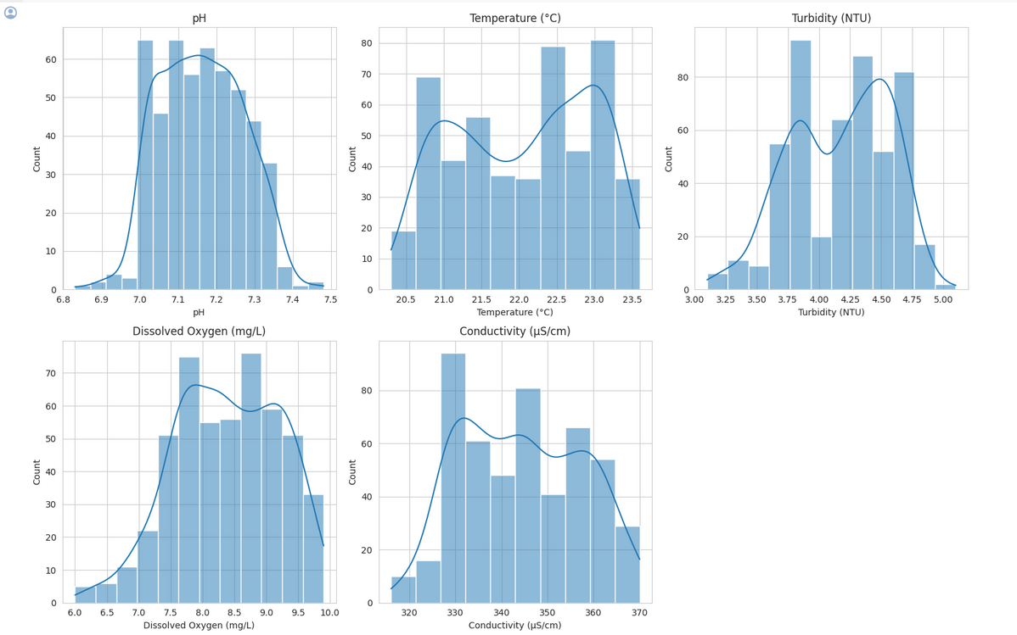
ANALYSIS
Notes:
pH: The distribution of pH values is roughly normal, centered around the mean value, indicating a consistent water quality in terms of acidity or basicity across samples.
Temperature (°C): The temperature distribution is also approximately normal, with most samples clustering around the mean temperature.
Turbidity (NTU): Turbidity shows a slightly right-skewed distribution, suggesting that while most water samples have low turbidity, a few samples have higher turbidity levels.
Dissolved Oxygen (mg/L): The dissolved oxygen levels are fairly normally distributed, indicating a consistent availability of oxygen across the water samples.
Conductivity (µS/cm): The conductivity of the water samples is normally distributed, with a slight skew towards higher values, indicating variations in the ionic content of the water samples.
These distributions suggest that the water quality parameters are relatively stable across the samples, with a few exceptions in turbidity and conductivity that might indicate specific areas or conditions where water quality varies more significantly.

Slide 6
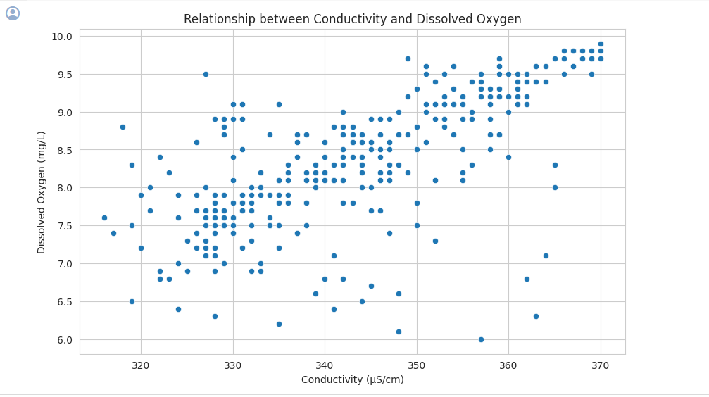
Notes:
"The correlation coefficient between Conductivity and Dissolved Oxygen is around 0.76, which means there's a strong positive relationship between these two factors.
In other words, when Conductivity (measured in microsiemens per centimeter, µS/cm) goes up, Dissolved Oxygen (measured in milligrams per liter, mg/L) tends to increase as well.
This is confirmed by the scatterplot, where we can see that as Conductivity increases, Dissolved Oxygen levels also rise.
So, the data shows that higher Conductivity is associated with higher Dissolved Oxygen levels."

Slide 7
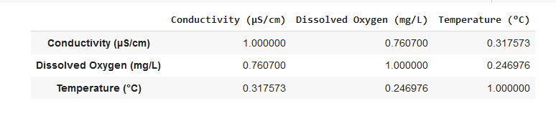
CORRELATION BETWEEN CONDUCTIVITY AND DISSOLVED OXYGEN
Conductivity and Dissolved Oxygen: 0.76 (strong positive correlation)
Conductivity and Temperature: 0.32 (moderate positive correlation)
Dissolved Oxygen and Temperature: 0.25 (weak positive correlation)
Notes:
The strong positive correlation between Conductivity and Dissolved Oxygen is consistent with our previous analysis.
The moderate positive correlation between Conductivity and Temperature suggests a relationship, while the weak positive correlation between Dissolved Oxygen and Temperature indicates a less significant relationship.

Slide 8
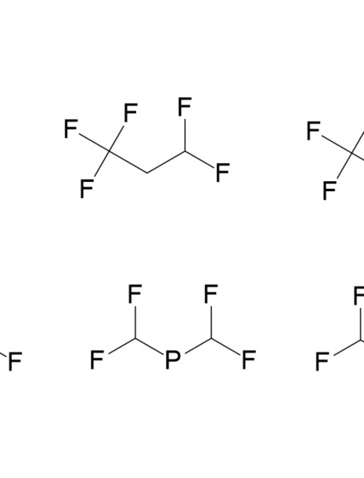
Understanding PFAS
Per- and polyfluoroalkyl substances (PFAS) are a group of man-made chemicals that includes PFOA, PFOS, GenX, and many other chemicals. PFAS have been manufactured and used in a variety of industries around the globe, including in the United States, since the 1940s. PFAS have properties that make them very useful for repelling water, oil, stains, grease and heat. Most PFAS do not break down easily in the environment or in our bodies and can build up over time.

Slide 9
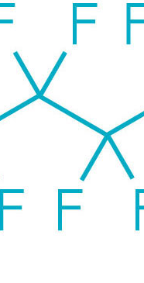
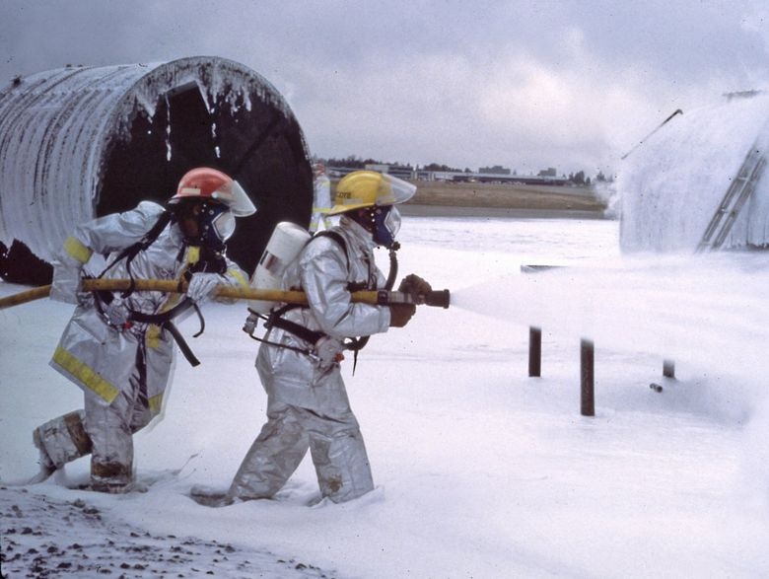

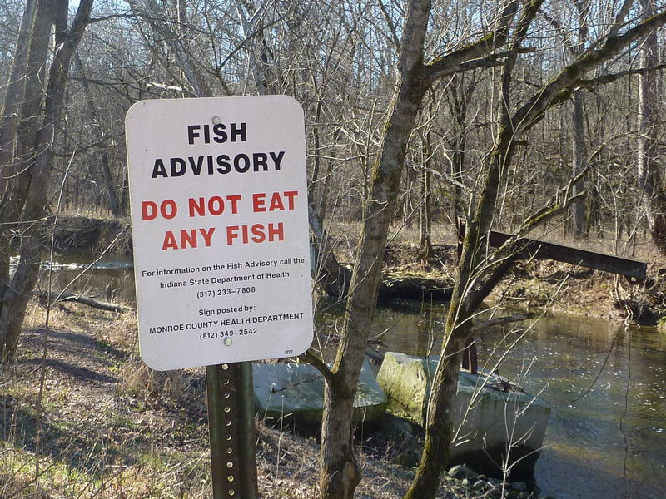
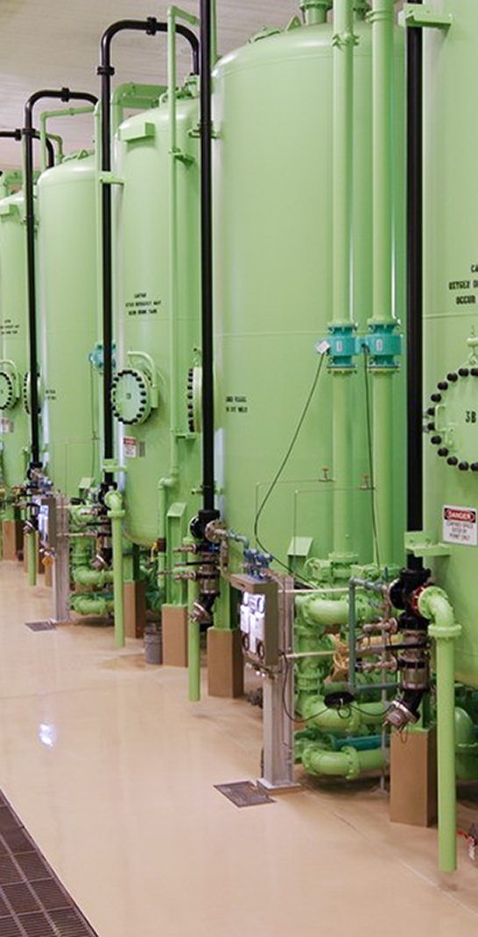
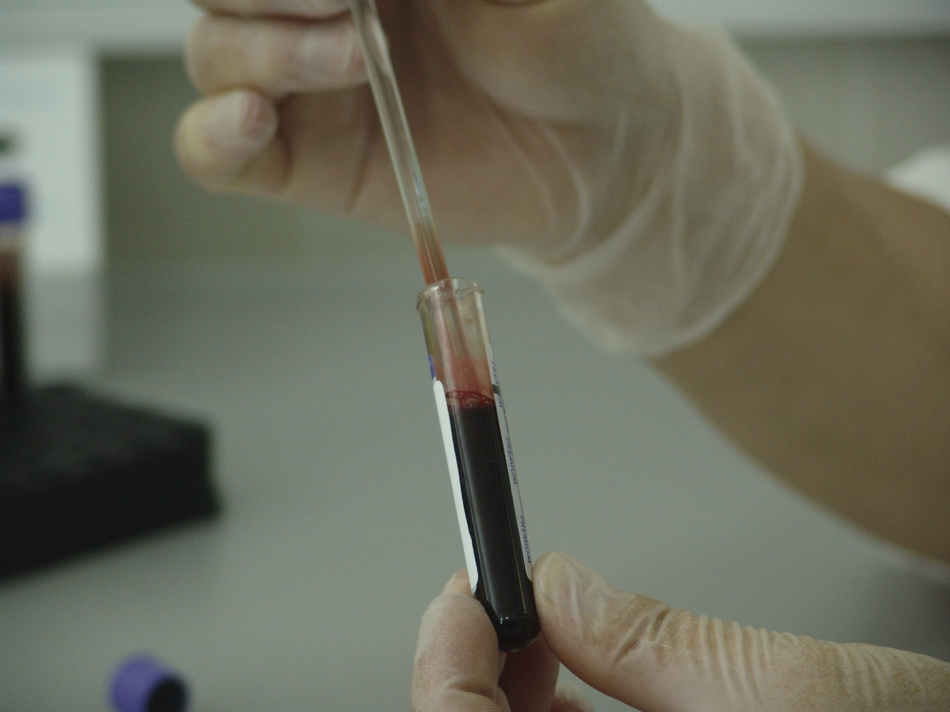
Rising PFAS Levels
PFAS chemical structure
Foam used in firefighting
PFAS water contamination
Fish consumption advisory
Water treatment facility
Blood sampling
A medical professional drawing blood to test for PFAS exposure
Molecular model of a PFAS compound
A firefighter spraying aqueous film-forming foam containing PFAS
Glass of water with a warning sign about PFAS contamination
A sign advising limiting consumption of fish due to PFAS contamination
An industrial water treatment facility filtering PFAS compounds

Slide 10
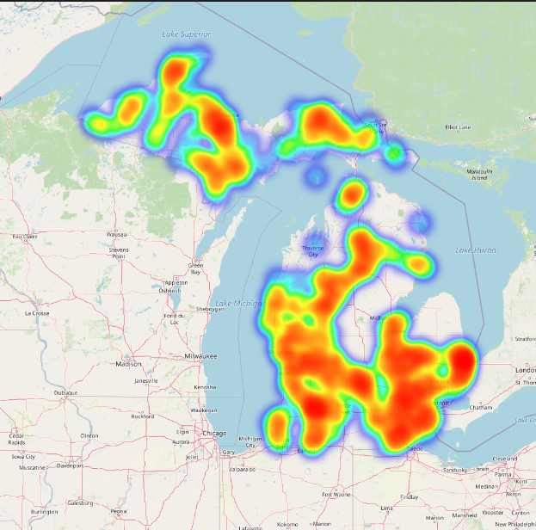
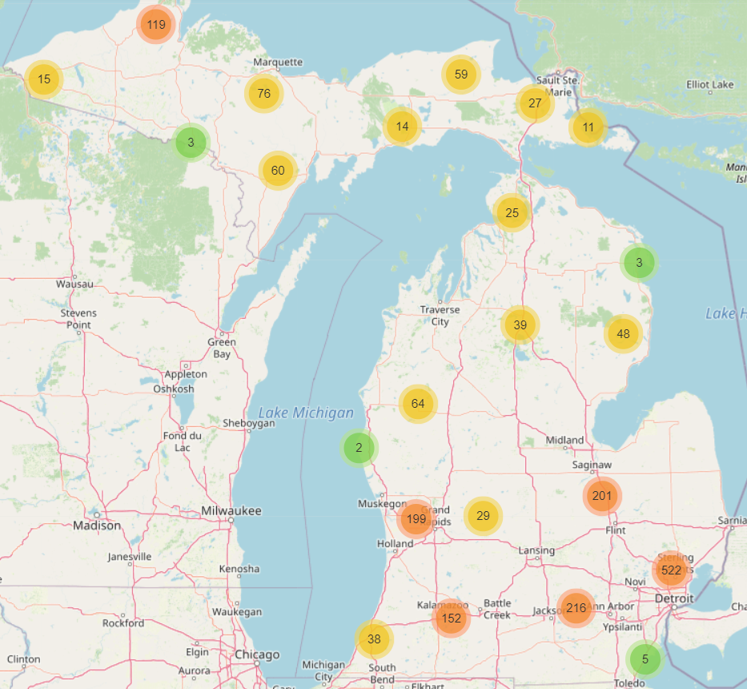
Michigan Surface Water Overview
Heat map of Michigan Surface Water
Sample locations
A map highlighting the major rivers, lakes, and watersheds in Michigan.
An overview of total samples collected over the specified area.

Slide 11
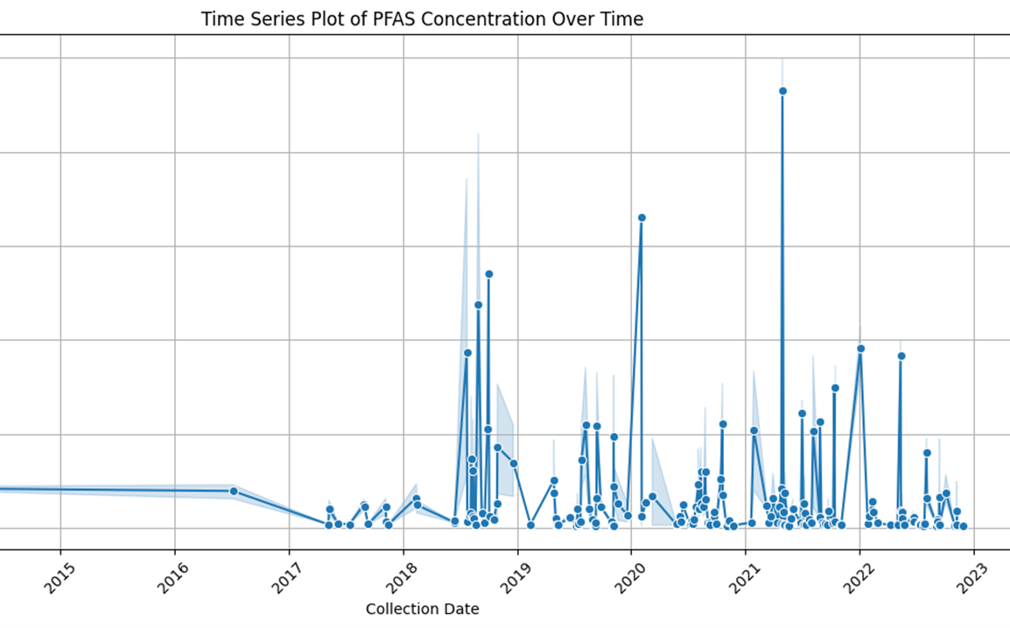
Notes:
Temporal Trends: The time series plot illustrates the trend of PFAS concentrations over time, showing periods of concentration spikes. Temporal trend analysis tracks changes in PFAS levels over different time periods, uncovering patterns of persistence, attenuation, or emergence.
Distribution Analysis: The histogram depicts the distribution of PFAS concentration values across the dataset, indicating attempts to reduce PFAS levels over time.
Spatial Analysis: Box plot visualizing the distribution of PFAS concentration levels across different watersheds, allowing comparison of concentration levels. Spatial distribution analysis reveals areas with elevated PFAS concentrations, pinpointing potential sources of contamination.
Key Points:
The primary aim of these visualizations is to identify hotspots and trends over time to assess the evolving nature of PFAS pollution.
Comparison with historical data enables assessment of long-term trends and evaluation of the effectiveness of mitigation measures.

Slide 12
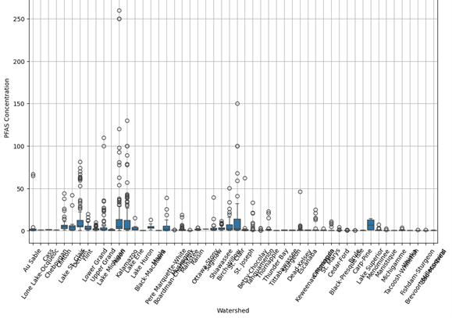

Slide 13
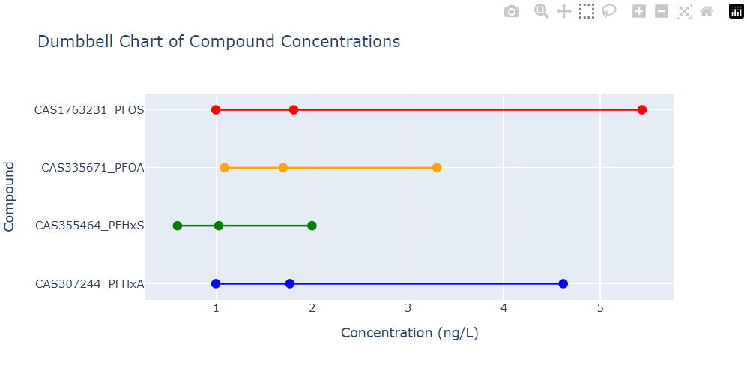

Slide 14
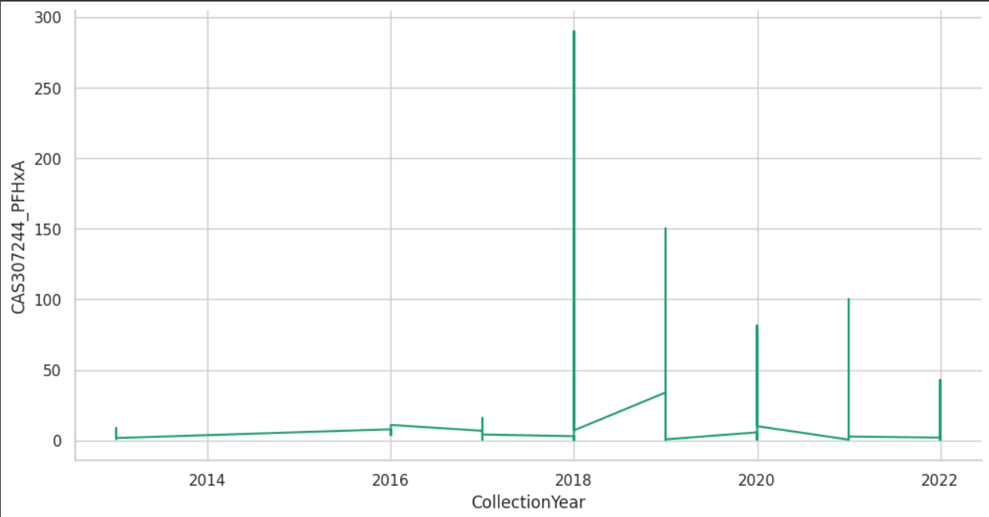
Plot showing the concentration of the compound CAS307244_PFHxA over the years

Slide 15


Effects of PFAS
Toxic effects
Cancer risk
Hormone disruption
Exposure to PFAS can lead to increased cholesterol levels, changes in liver enzymes, and reduced vaccine response in children.
Some PFAS like PFOA and PFOS are linked to testicular, kidney, and other cancers based on human and animal studies.
PFAS can interfere with body's endocrine system and affect thyroid hormone levels and reproductive outcomes.
PFAS exposure through environment and consumer products poses health risks like toxicity, cancer, and hormone disruption.

Slide 16
Case Study: Flint Water Crisis
Flint switches its water supply from Lake Huron to the Flint River to reduce costs.
Researchers find dangerous levels of lead in Flint's water.
April 2014
October 2015
August and September 2014
Residents complain of smelly, discolored water.

Slide 17



Causes of Flint Crisis
Cost-cutting measure by State Government
Neglect of corrosion control treatments
Aging and damaged water infrastructure
Lack of transparency and accountability

Slide 18




Consequences of Flint Crisis
Lead poisoning
Loss of trust
Legal issues
Financial impacts
High lead levels found in children's blood
Government seen as negligent by residents
Lawsuits filed over water crisis
Costs for new infrastructure, medical care
The Flint water crisis had severe health, social, legal and economic impacts on the city's residents.

Slide 19

Lessons Learned
The Flint water crisis revealed major gaps in drinking water oversight, especially for low-income communities. Key lessons learned include the need for more frequent and rigorous water testing, improved communication of risks, and investments in water infrastructure upgrades. Response measures have focused on lead pipe replacement, added corrosion control, and providing residents with filters and bottled water.

Slide 20




PFAS Mitigation Strategies
Implement New Regulations
Phase Out PFAS Production
Treatment Technologies
Site Remediation
Develop and implement new regulations to limit PFAS use and discharge. Set enforceable PFAS concentration limits for air emissions, wastewater discharge, and drinking water.
Require manufactures to phase out production and use of certain PFAS chemicals. Prioritize elimination of long-chain PFAS.
Utilize advanced treatment technologies like granular activated carbon to remove PFAS from drinking water supplies.
Identify and cleanup PFAS contamination at industrial sites and military bases. Use technologies like pump-and-treat and soil excavation.

Slide 21
REFERENCES
Analysis of F-53B, Gen-X, ADONA, and emerging fluoroalkylether substances in environmental and biomonitoring samples: A review - ScienceDirect
Exposure to PFOS, PFHxS, or PFHxA, but not GenX, Nafion BP1, or ADONA, Elicits Developmental Neurotoxicity in Larval Zebrafish | Science Inventory | US EPA
PFAS – PFOA, PFOS, PFNA and More Lab Testing
PFAS REPLACEMENT COMPOUNDS “The Next Generation”
PFAS contamination in West Michigan has unfortunately made headlines.

Slide 22
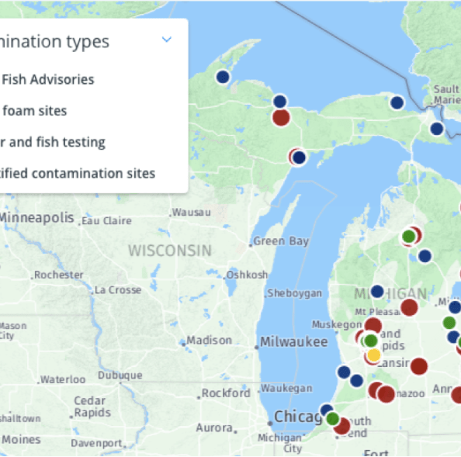
Conclusion
In conclusion, the findings from our water quality monitoring of Michigan's surface waters demonstrate widespread PFAS contamination. This highlights the need for continued monitoring and regulatory action to protect public health. We encourage all stakeholders to support efforts to limit additional PFAS discharges and clean up existing pollution.

